Slide 1

MTA Data Analysis of NYC Subway for WTWY
By Eddy, Yingzhao and Ashvine
17 April 2020

Slide 2

Objectives
Our goal is to help WTWY teams in achieving maximum email signups.
This will help them increase their fundraising on the gala night.

Slide 3



Methodology
Using the New York City subway data to analyse transit patterns of commuters in order to optimize WTWY team placement.
We analysed one week’s worth of turnstile data from the MTA datasets and given our short time frame, we used a minimum viable product (MVP) approach to come up with a simple, workable and value-added product.
We used data from the top 5 busiest stations for a period of 24hours for each day of the week.
For each station, we added both their entry and exit data.
Data analysis with

Slide 4

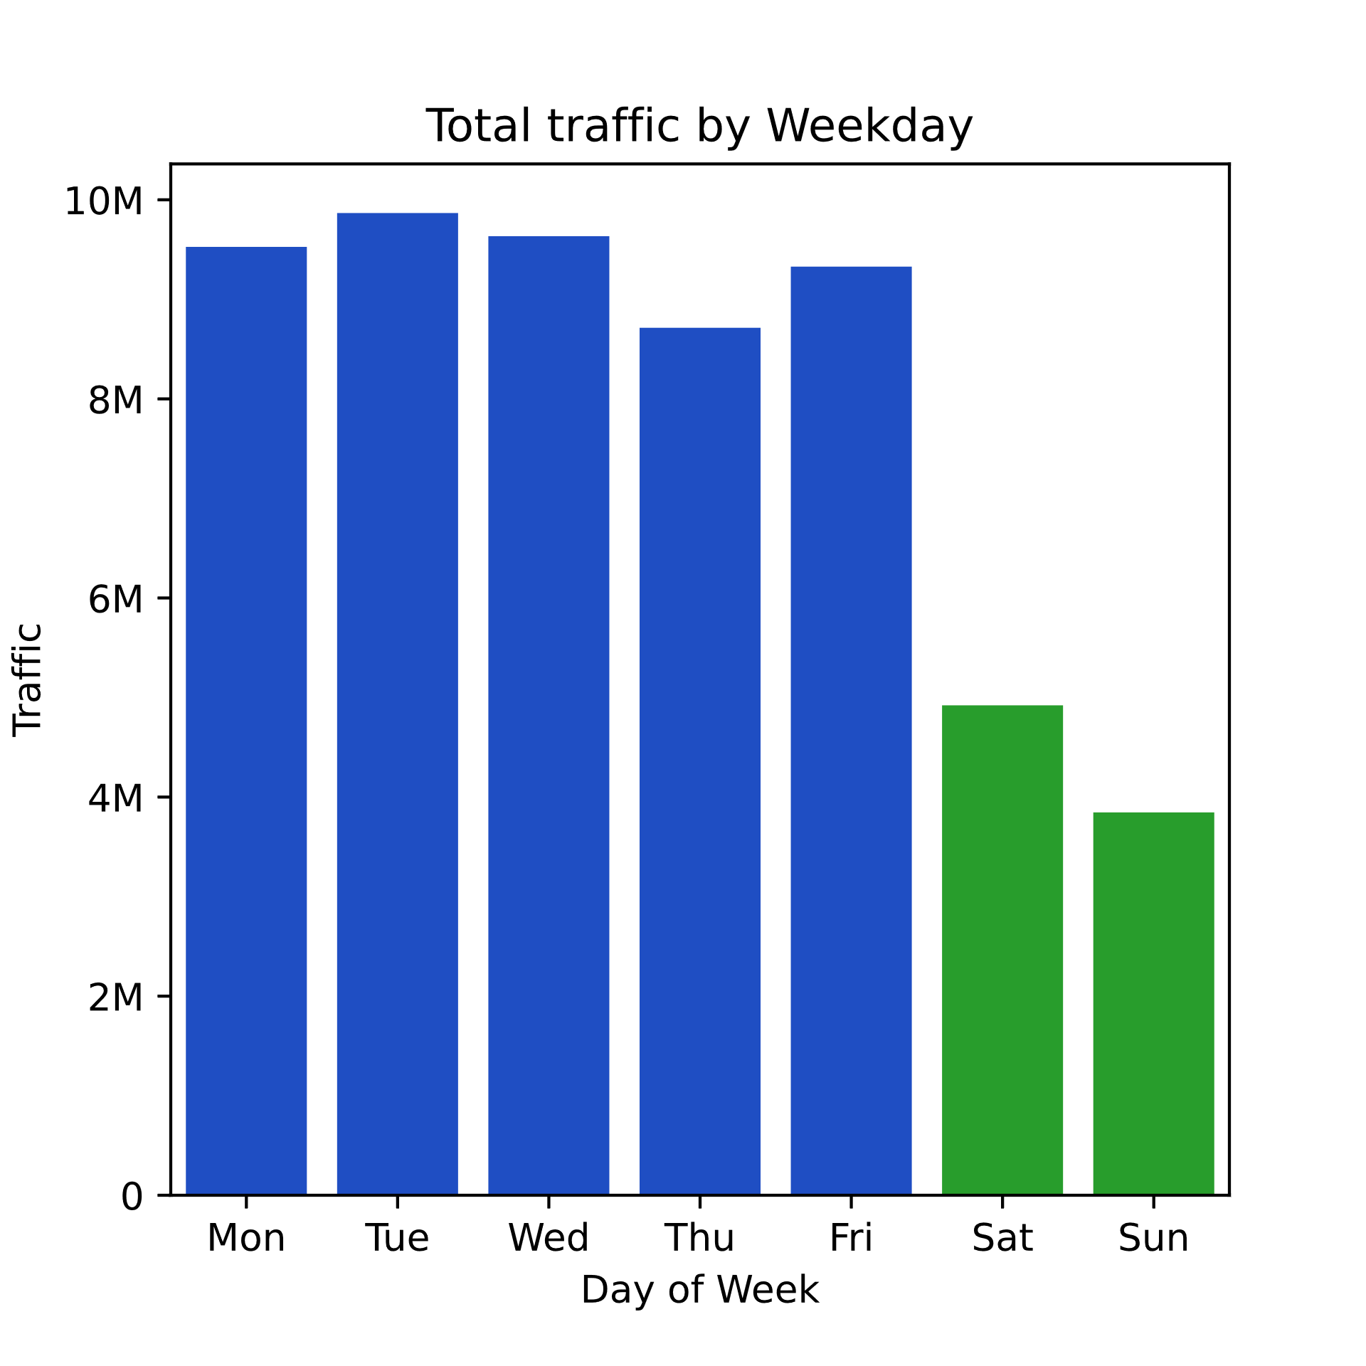
Key Findings
All MTA NYC Stations for week ending 2 Feb 2019
Weekends generally see less traffic
Weekdays generally see more traffic

Slide 5
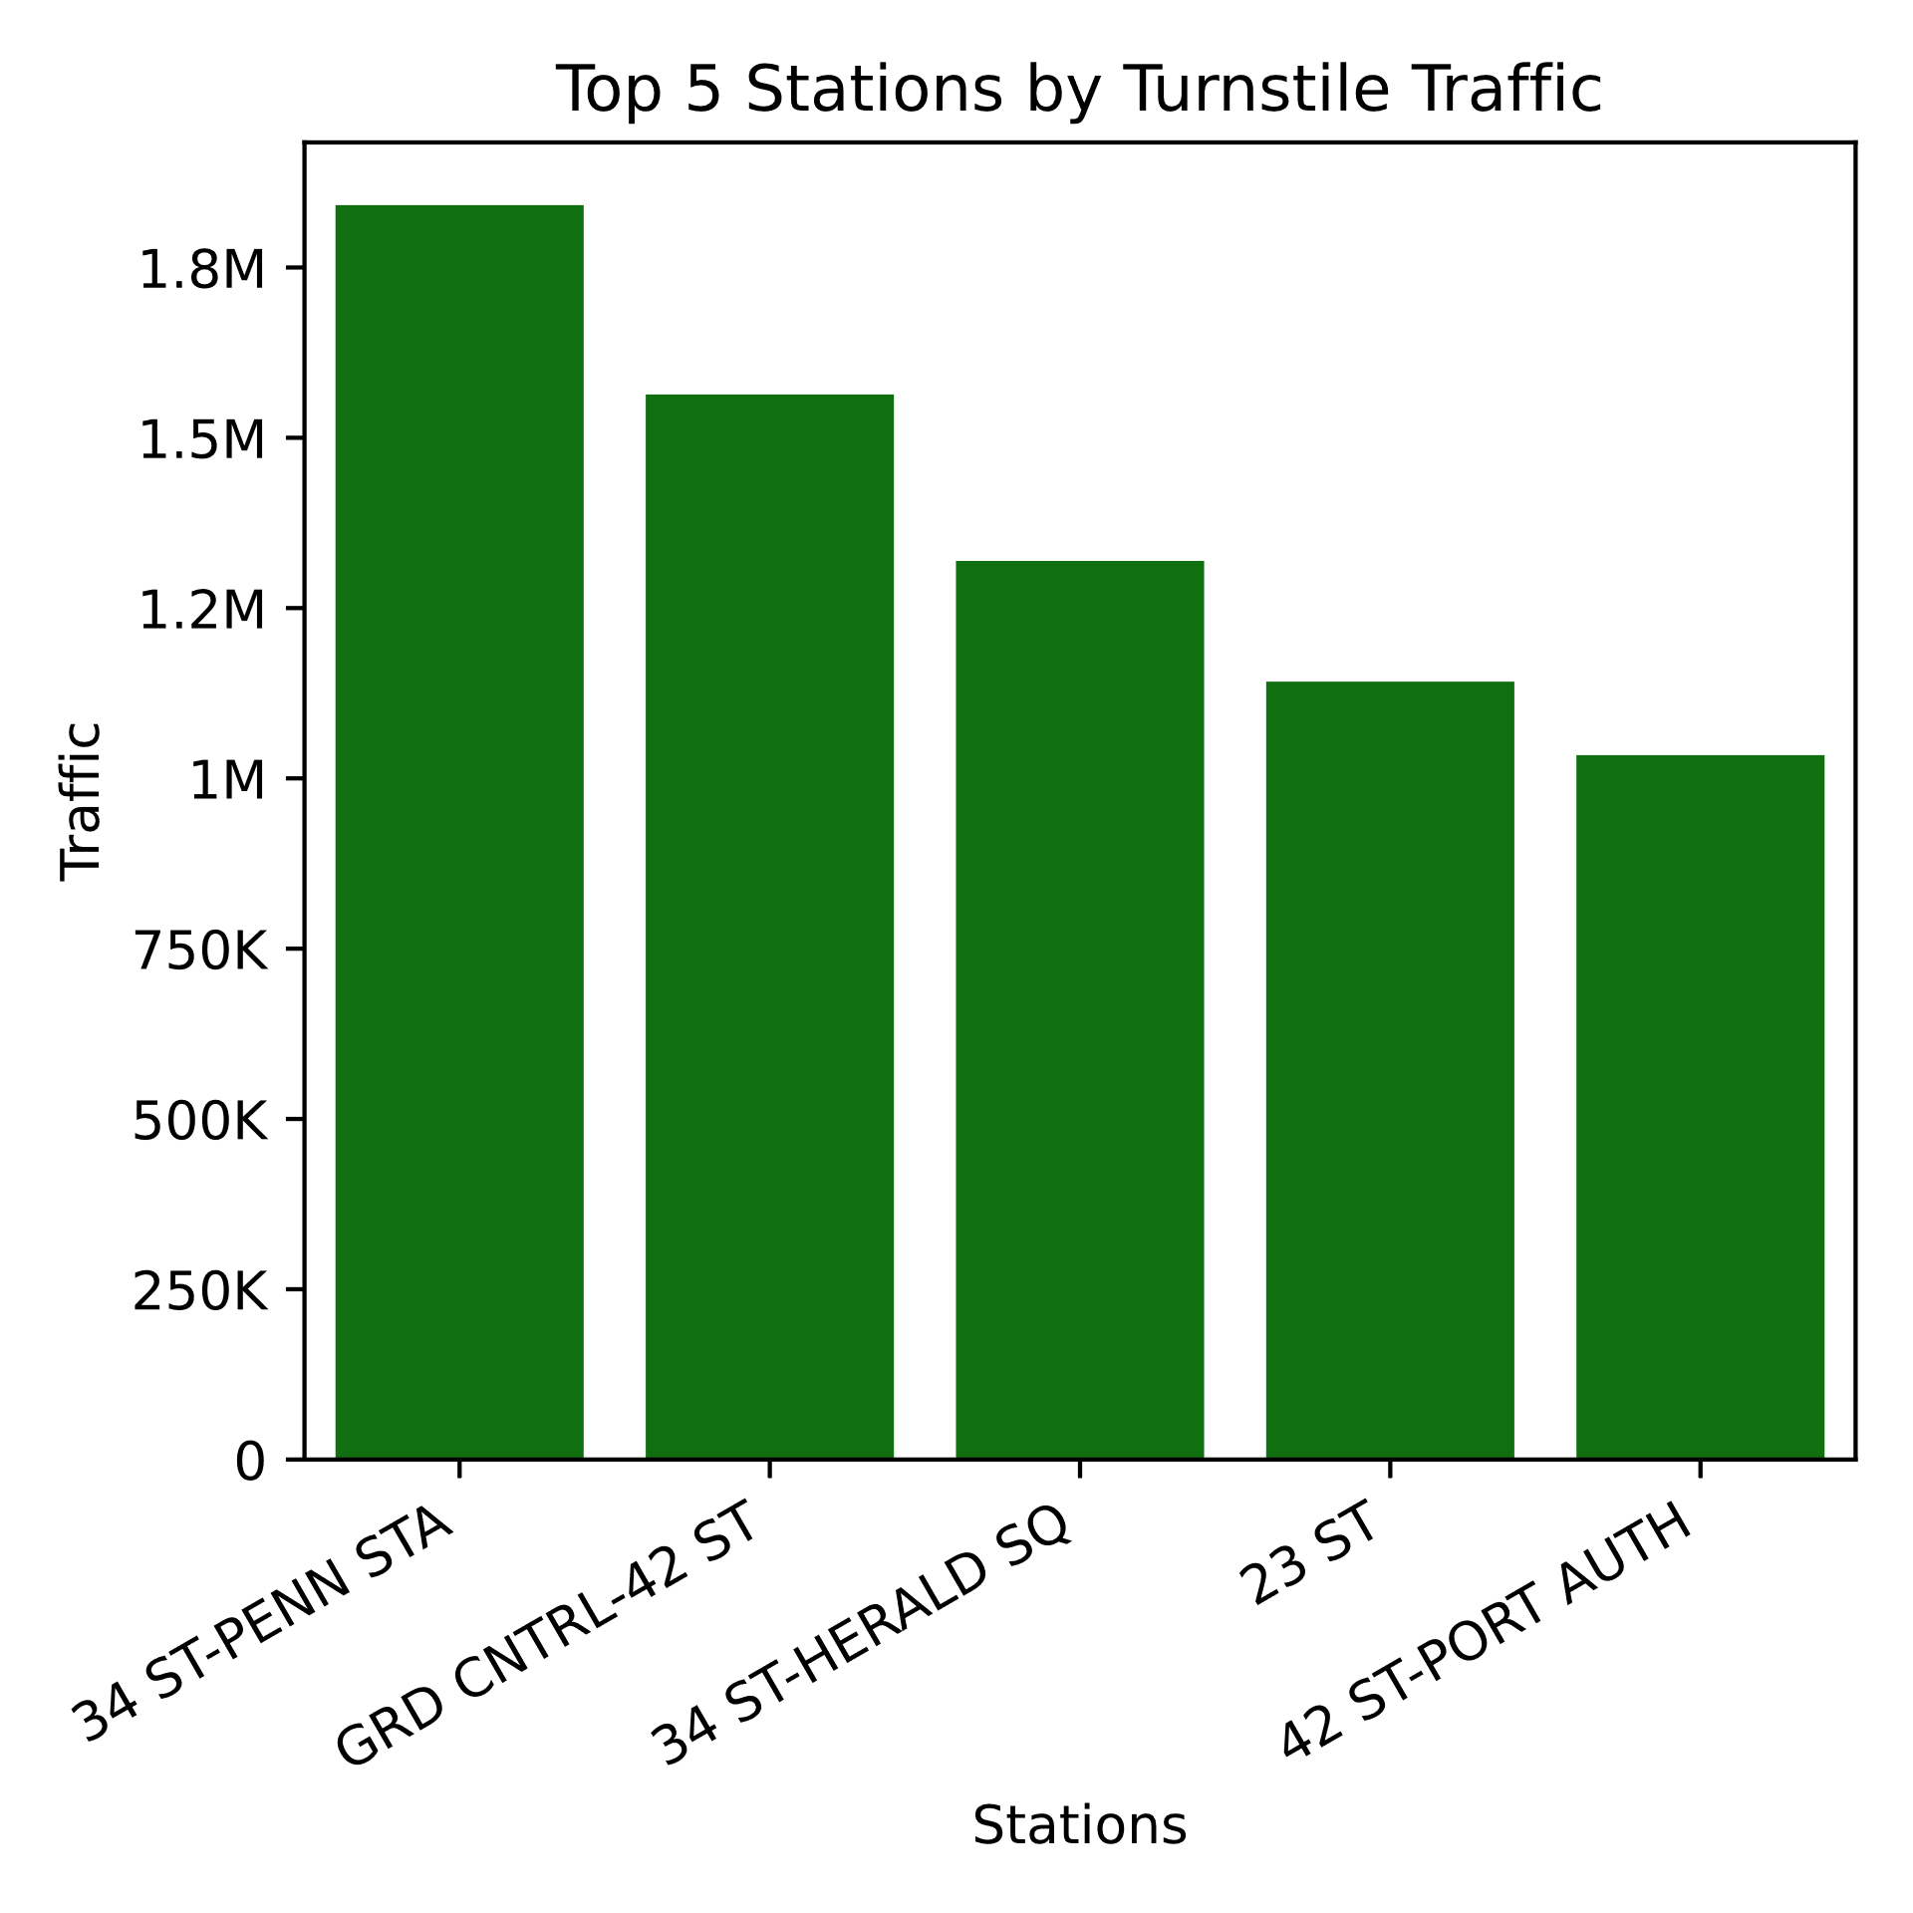
Key Findings
Week ending 2 Feb 2019
Top stations are the following:
Penn Station
Grand Central
Herald Square
23rd Street
Port Authority
Focus on these stations

Slide 6
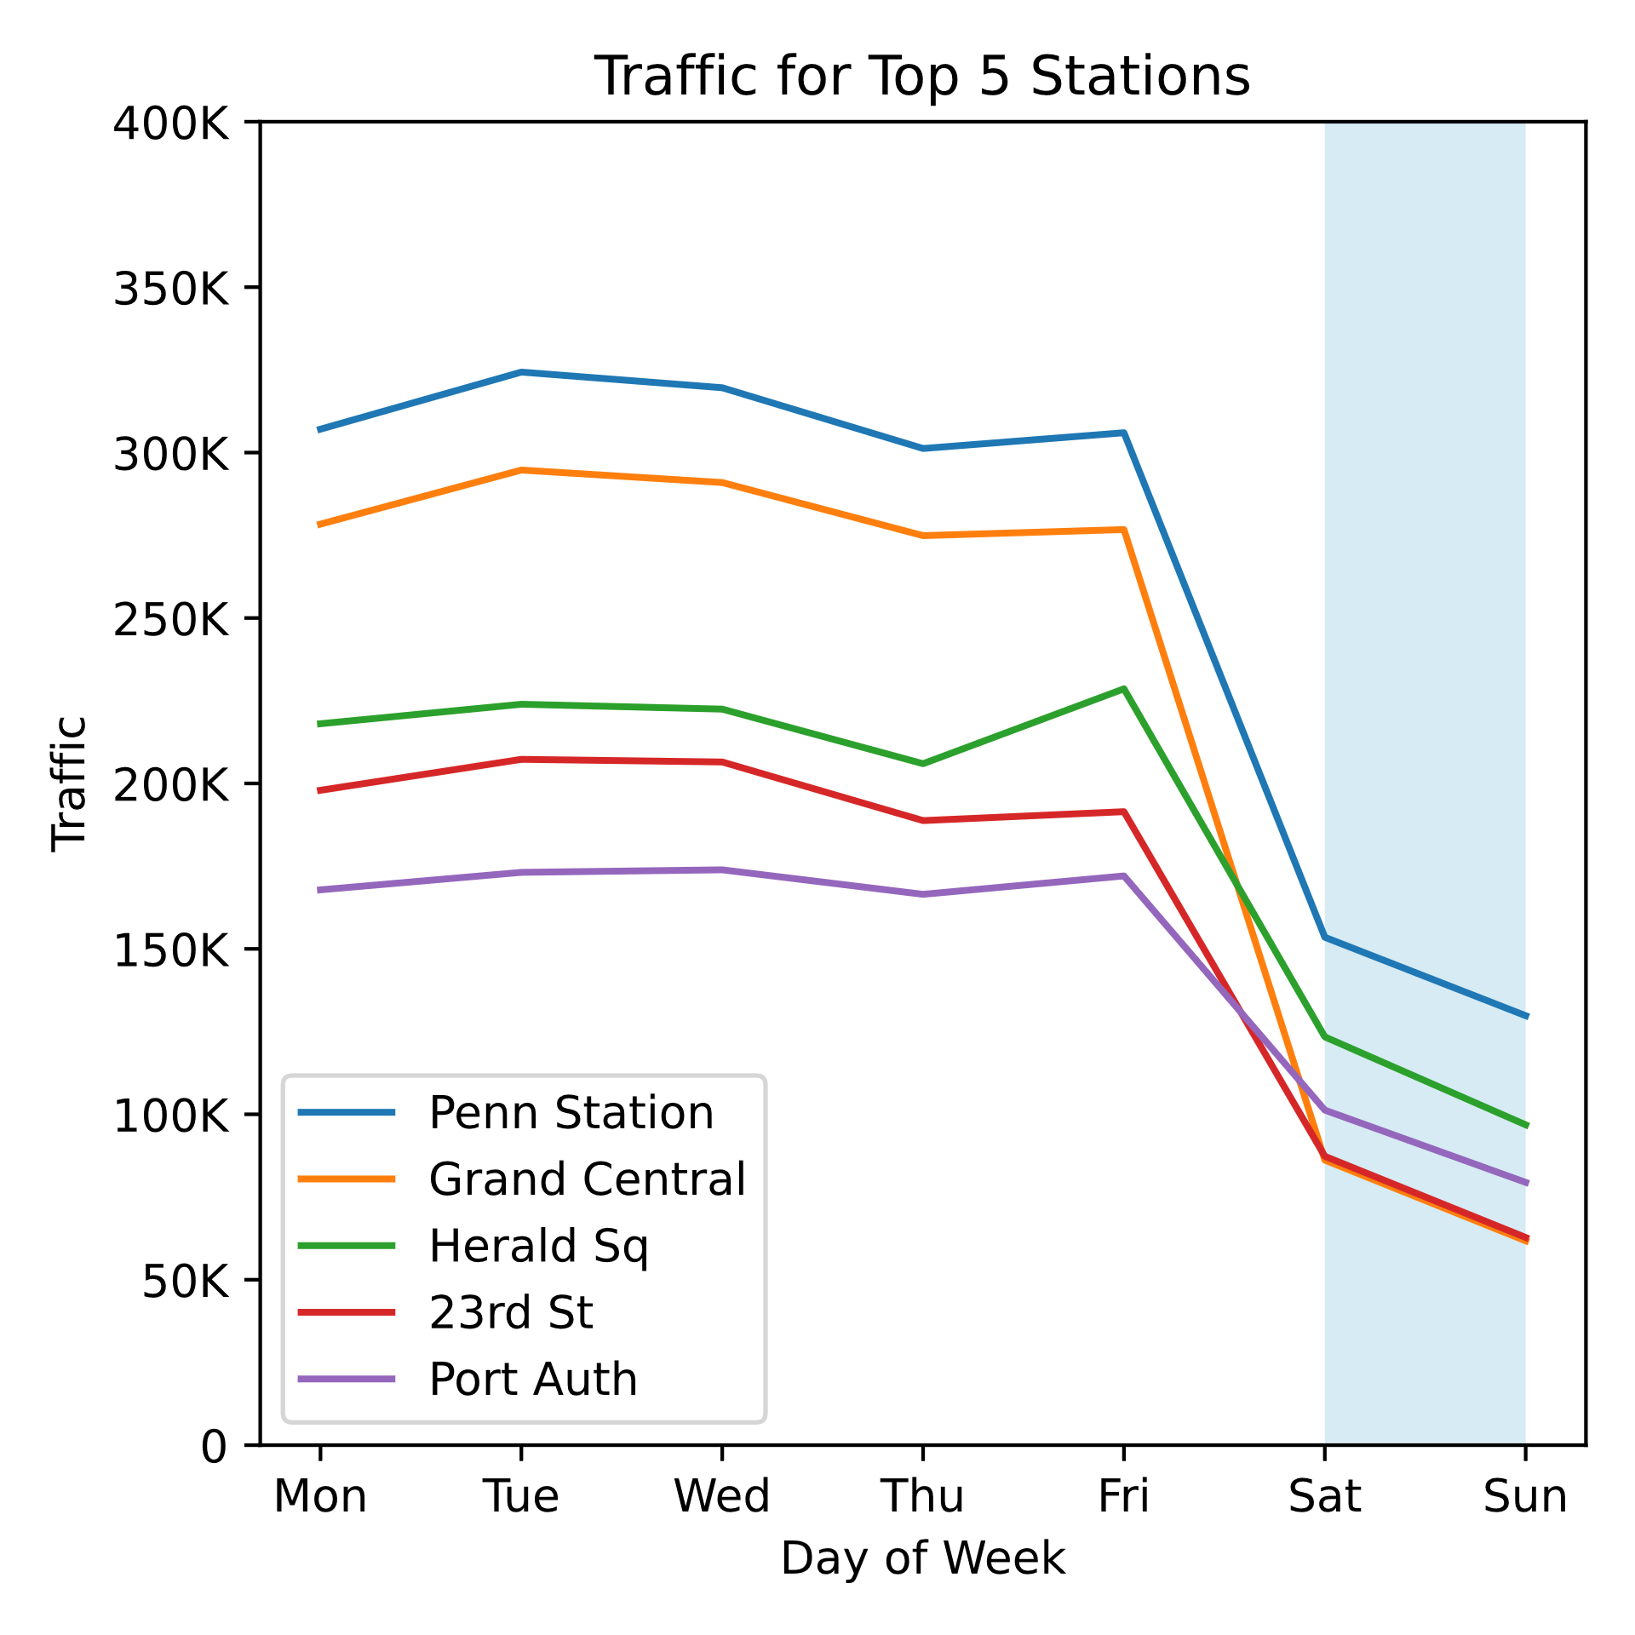
Key Findings
Week ending 2 Feb 2019
All five stations have similar patterns of traffic
Low on weekends (blue highlight)
High on weekdays
Focus on weekdays

Slide 7
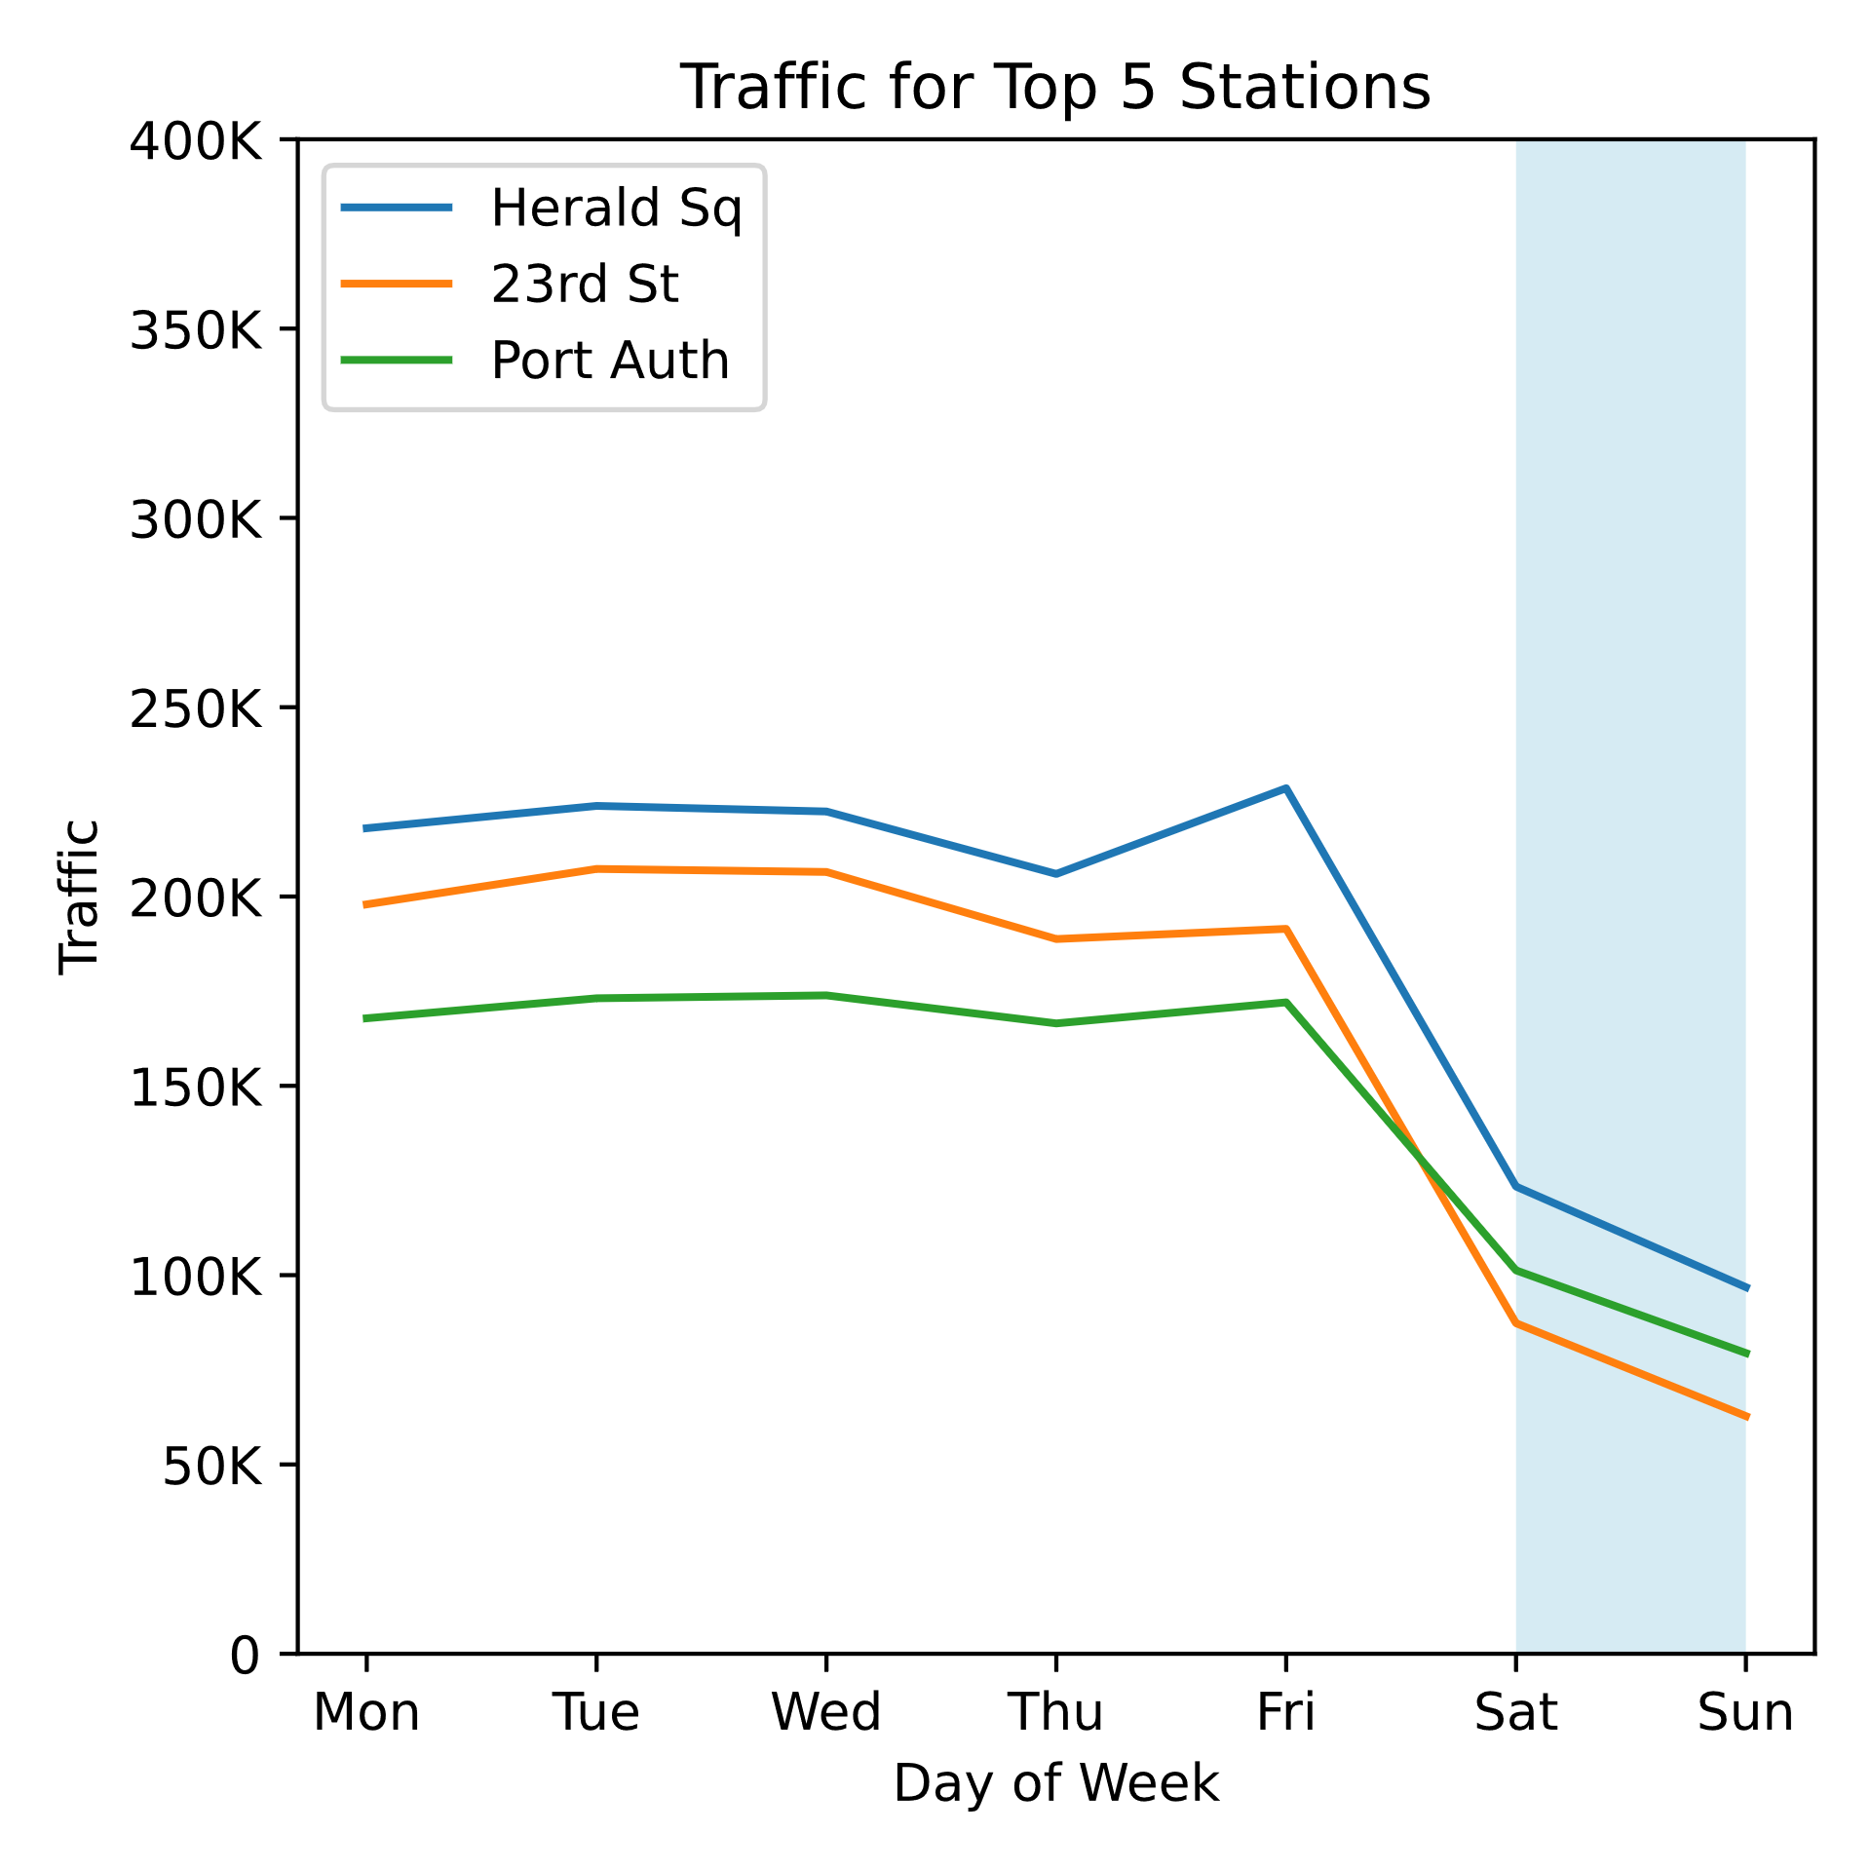
Key Findings
Week ending 2 Feb 2019
Some stations have flatter traffic patterns than others
Could be in or near tourist areas
Tourists unlikely to attend conference
May be better to skip these stations
… and go for the 6th – 8th ranked stations

Slide 8

Next Steps: Identify 3 more areas…
Top Month
Top Stations
Peak Hours

Slide 9



…to support Women Tech Women Yes

Slide 10
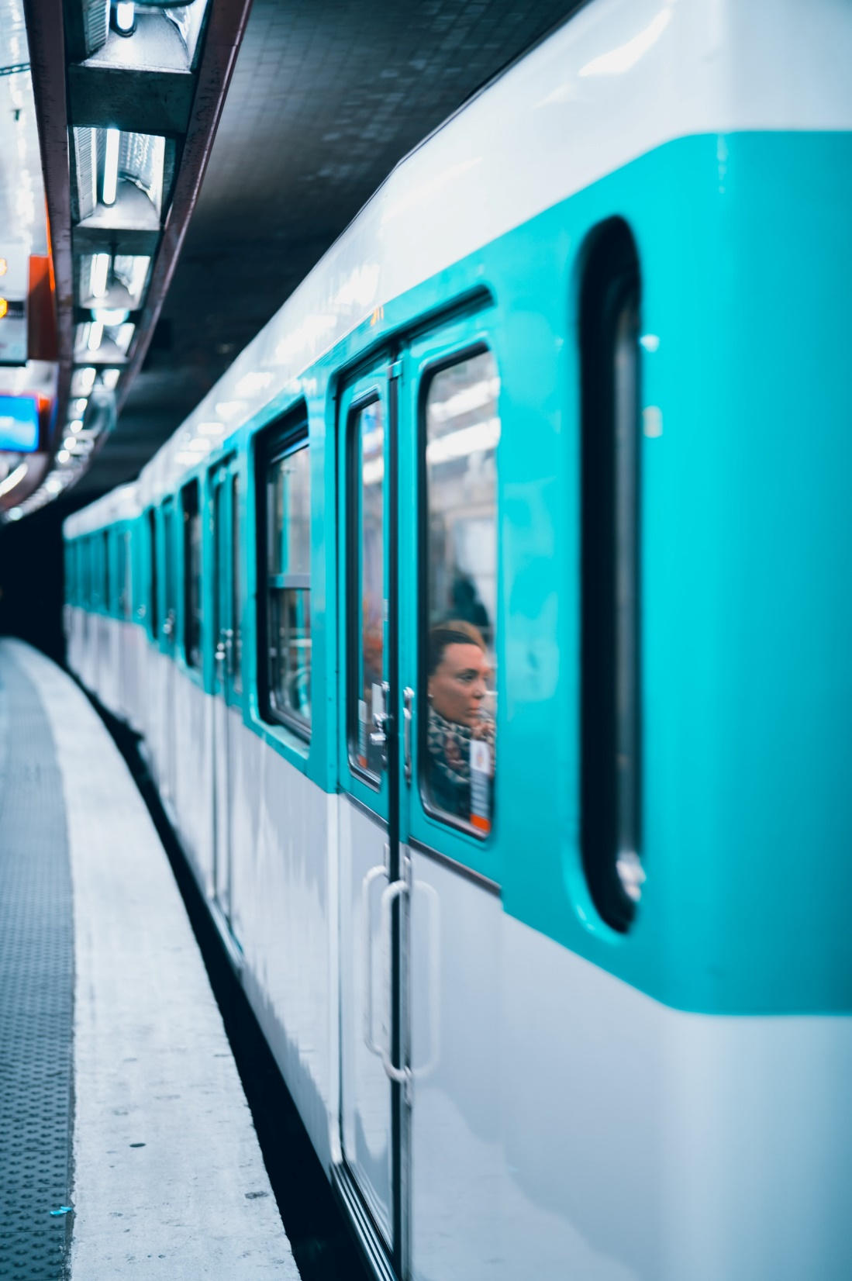
Thank You

Slide 11
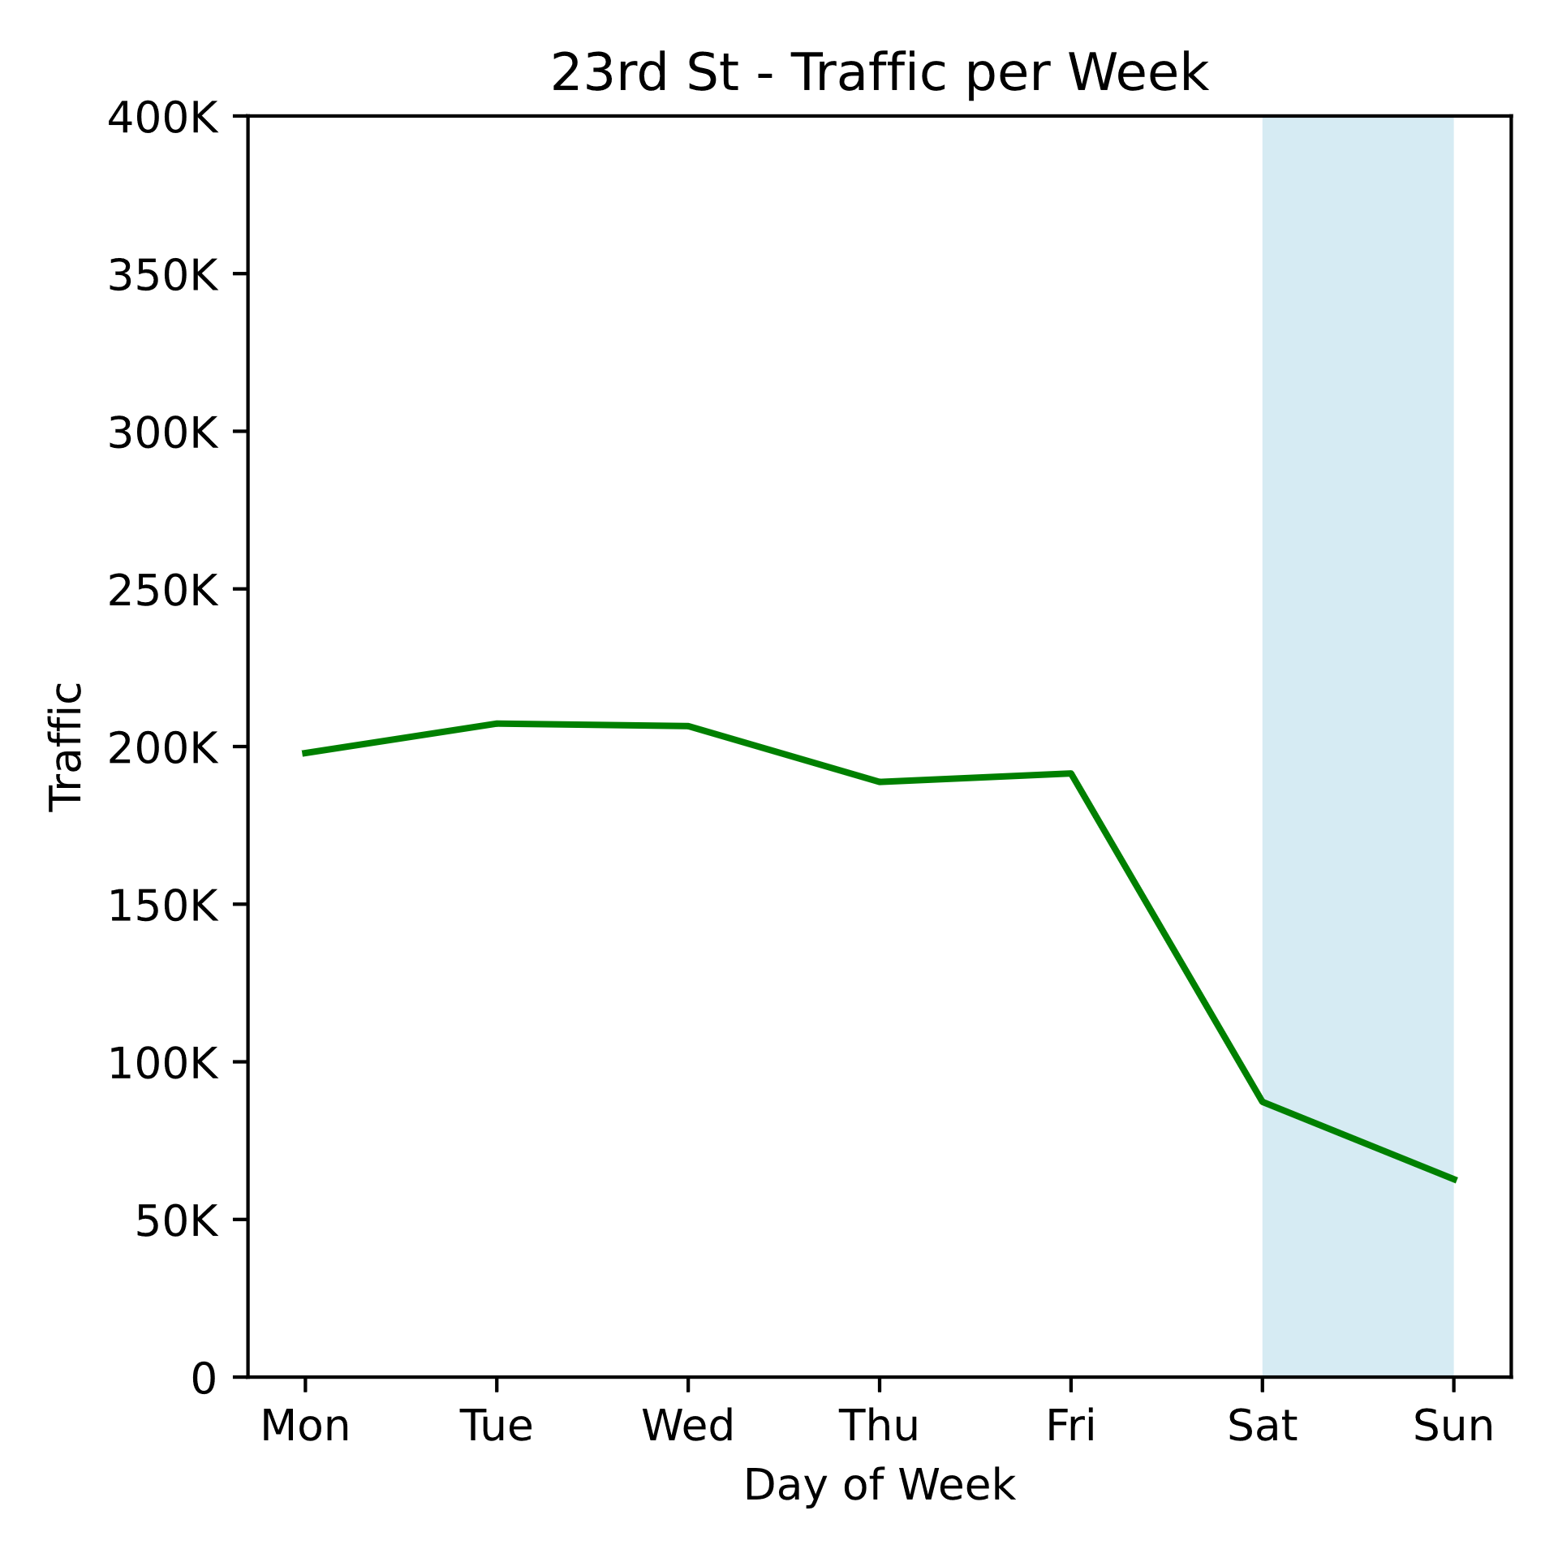
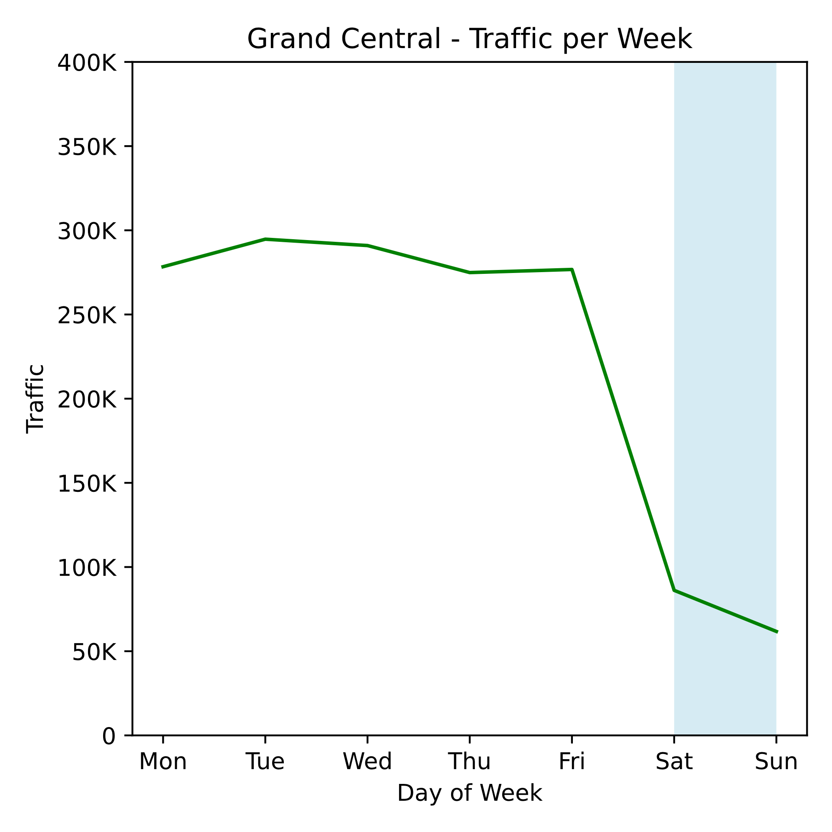
Appendix 1 – Entries for each station

Slide 12
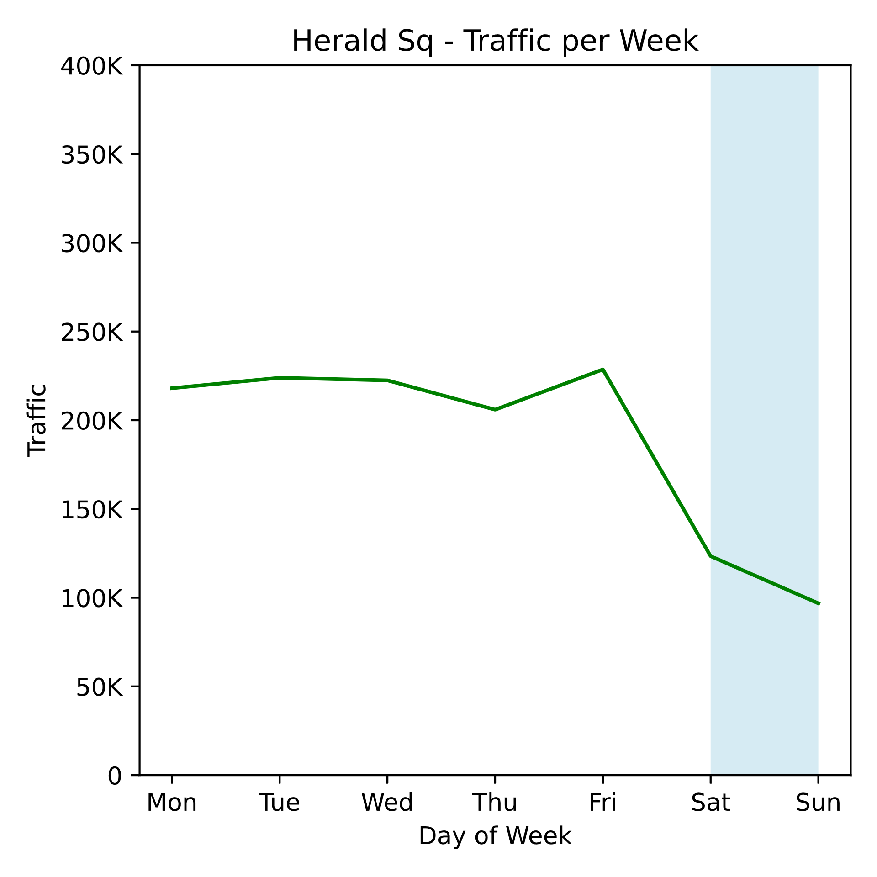
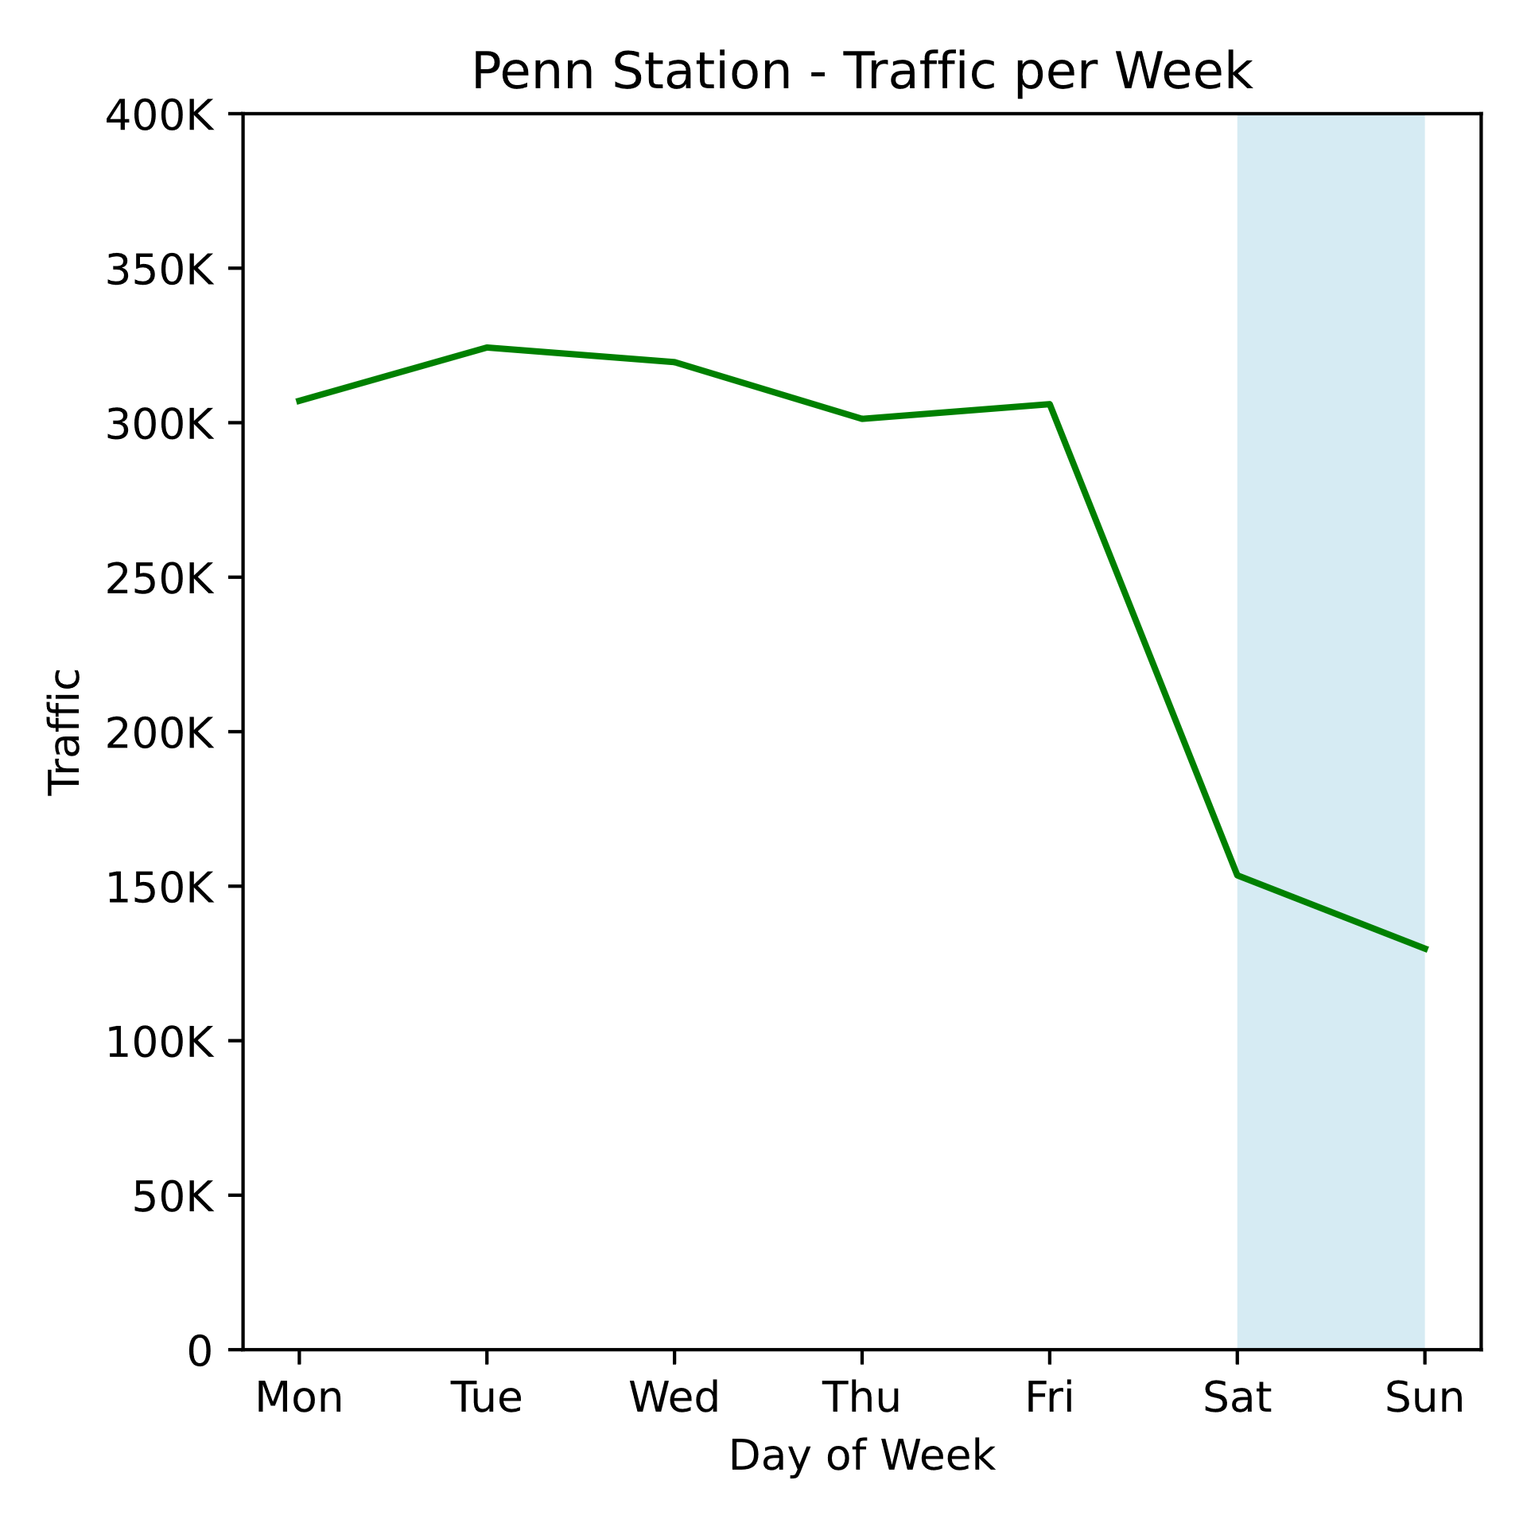
Appendix 1 (contd)

Slide 13
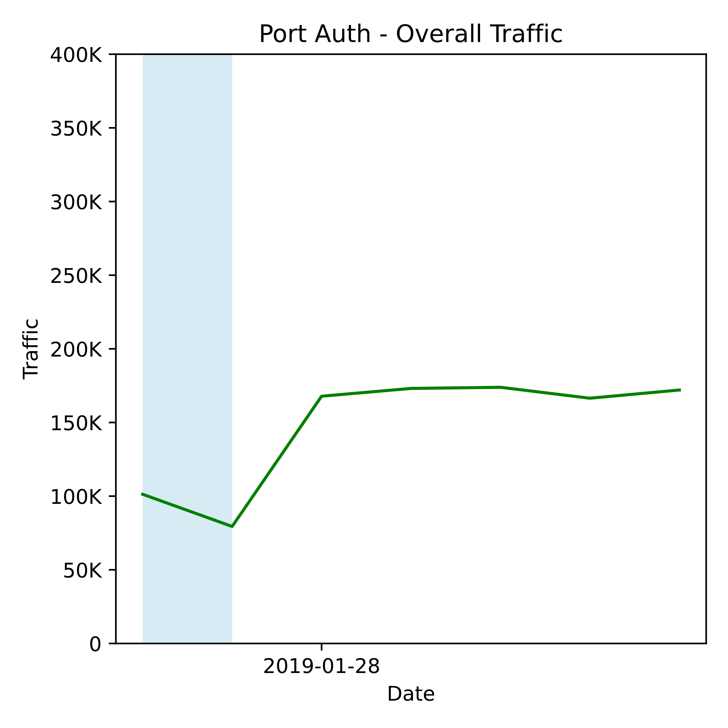
Appendix 1 (contd)

Slide 14
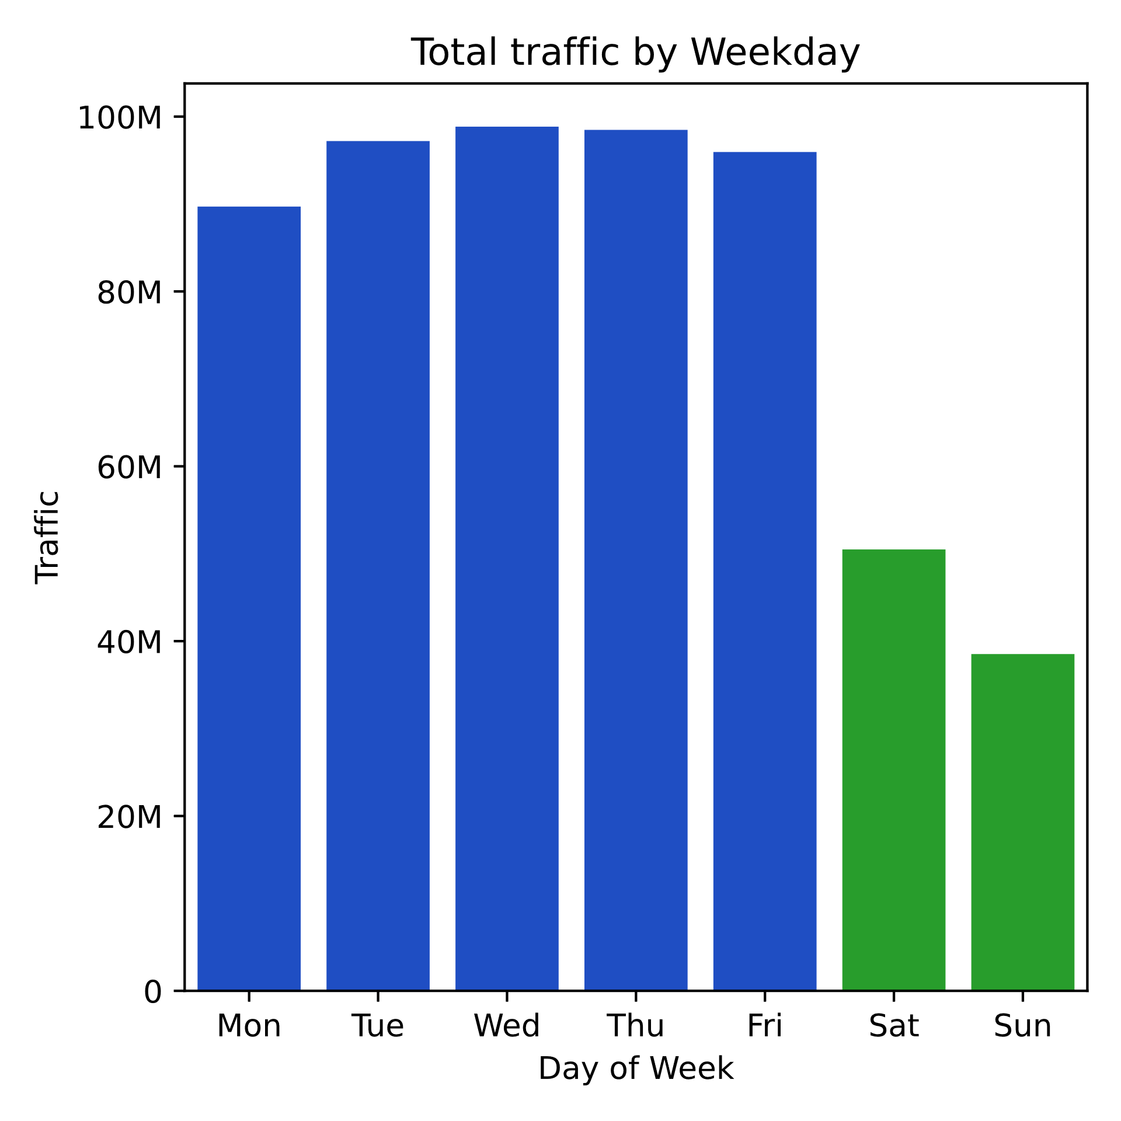
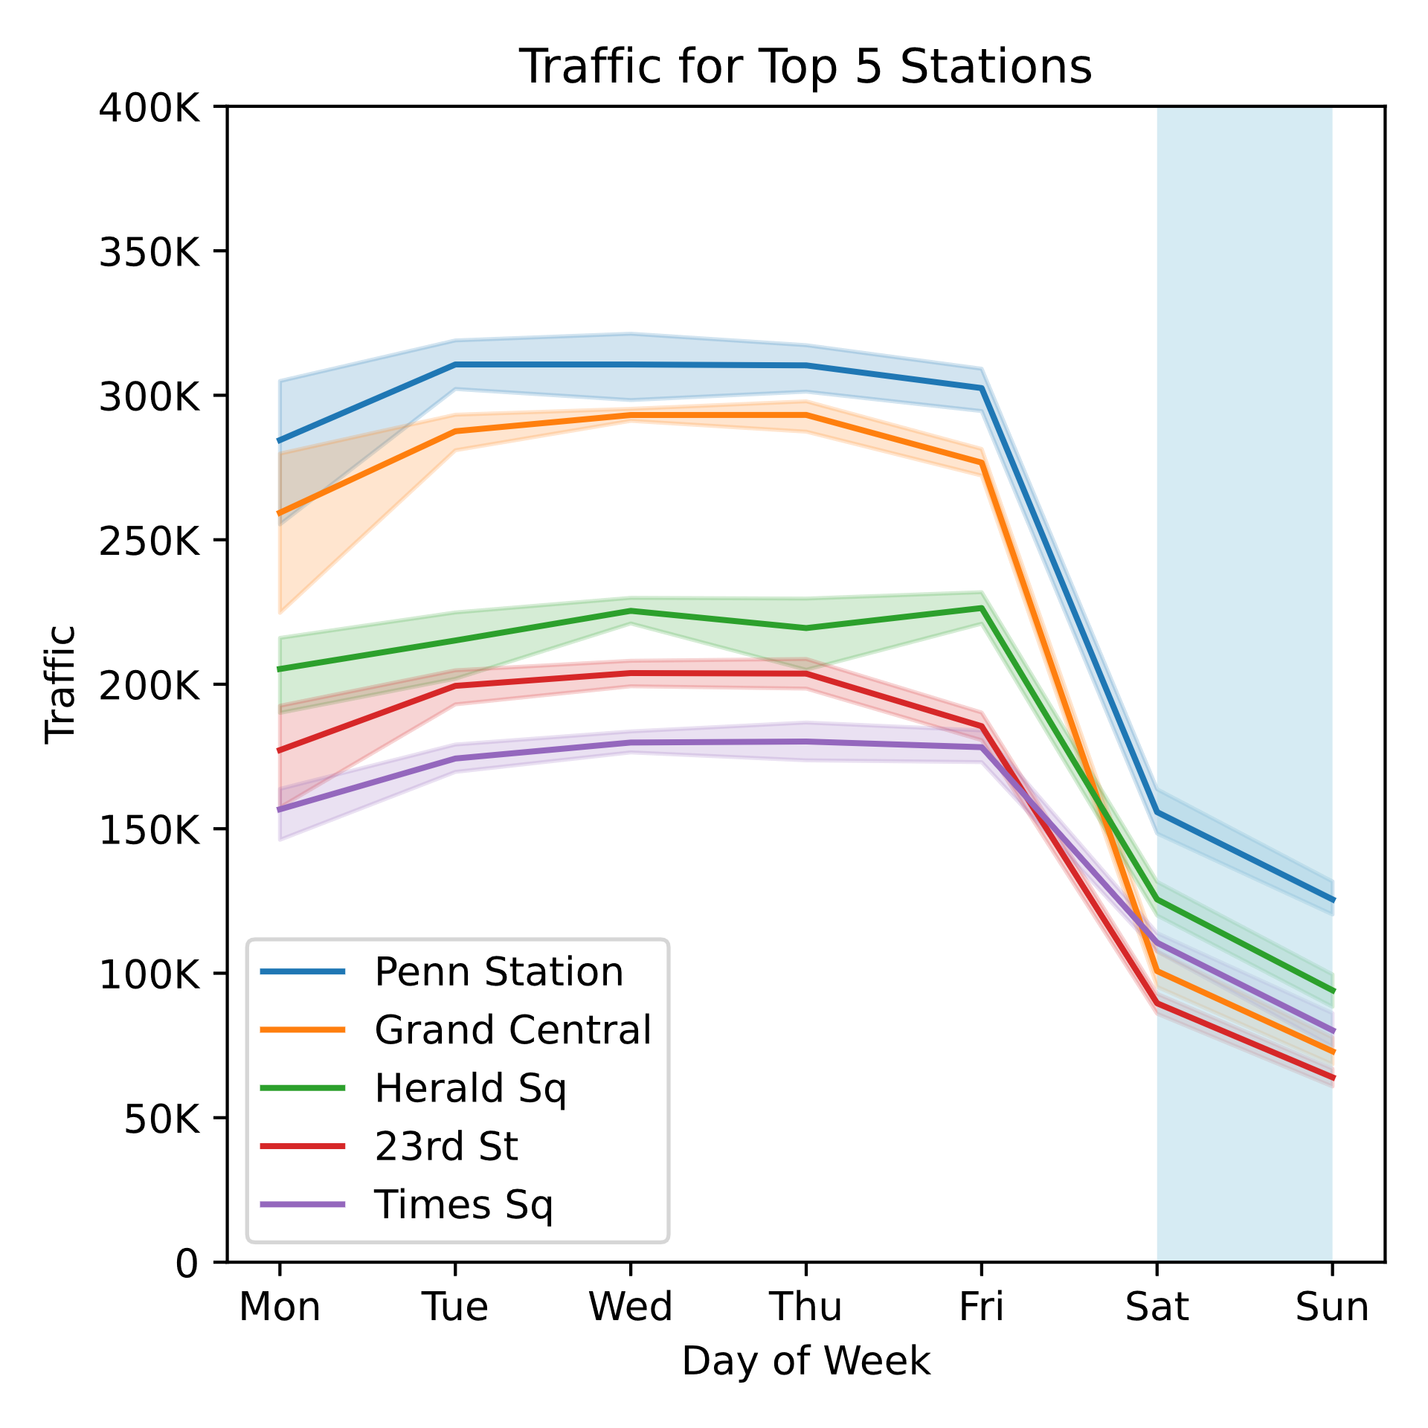
Appendix 2 (10-week overview)

Slide 15
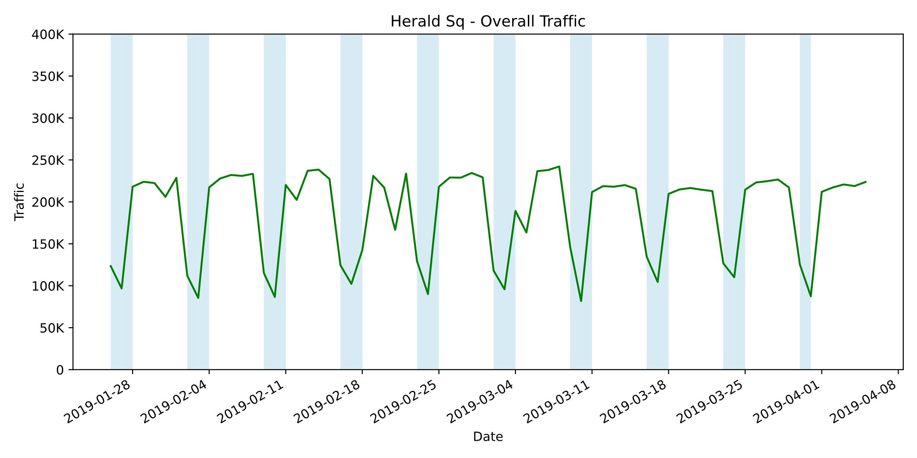
Appendix 3 (fluctuation)

